Slide 1

Human resources slide 8
Information Integration project
Integrating heterogeneous data sources into a unified global schema
Goal of the project
Accomplishing a domain-based integration of multiple and heterogenous data sources, merging them into a single global view that can be queried by the users. The global schema should be able to satisfy queries not trivially satisfiable by accessing directly the data sources.

Slide 2
GAV – Mappings (1)
In GAV approach, the (sound) mappings are assertions as such:
∀x. φS(x) → g(x)
Where:
S is the source schema
φS is a CQ over the source DB
g is a predicate of arity n that indicates an element of G
GAV (Global As View): the global schema is a view of the set of sources

Slide 3



GAV – Retrieved global database (2)
Given I = <G, S, M> and source database C for S, we denote the retrieved global database as M(C), that is the database obtained by:
Applying the CQs specified in the mappings
Transferring the tuples from the sources to the global DB

Slide 4

Human resources slide 1
Data integration using Pentaho (1)
The end result of the project is a one-shot materialization of the global schema, achieved by mappings in the form of Pentaho transformations.

Slide 5
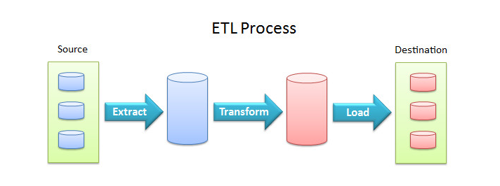
Human resources slide 1
Data integration using Pentaho (2)
Pentaho Kettle is a tool that allows loading input data in heterogeneous formats and from different sources, performing the transformations needed in order to map the information as requested.
Finally, the data is materialized in output as a SQL database in the example shown for this project.

Slide 6








Human resources slide 1
Domain and data sources (1)
Critic reviews
Directors
Users Ratings
Actors
Movies
Production studios
Energy scores
Oscar awards

Slide 7







Domain and data sources (2)
7 Data sources
13 Files (TSV, CSV, JSON)

Slide 8


Human resources slide 1
Domain and data sources (3)
title.principals.tsv
title.basics.tsv
name.basics.tsv
the_oscar_award.csv
ratings.csv
movies_metadata.csv
links.csv
movies.json

Slide 9
Human resources slide 1
Domain and data sources (4)
studios.csv
movies.csv
filmtv_movies.csv
rotten_tomatoes_critic_reviews.csv
rotten_tomatoes_movies.csv
9

Slide 10
Human resources slide 1
Domain and data sources – Reconciliation issues (5)
Physical heterogeneity Data stored in different formats: CSV, TSV and JSON Easily mitigated by Pentaho transformations that can handle multiple input formats
Conceptual heterogeneity
Different datasets uniquely identify movies in diverse formats: IDs both in string and number data types
Some datasets refer to movies with their original title, some with their English title, some have both fields

Slide 11
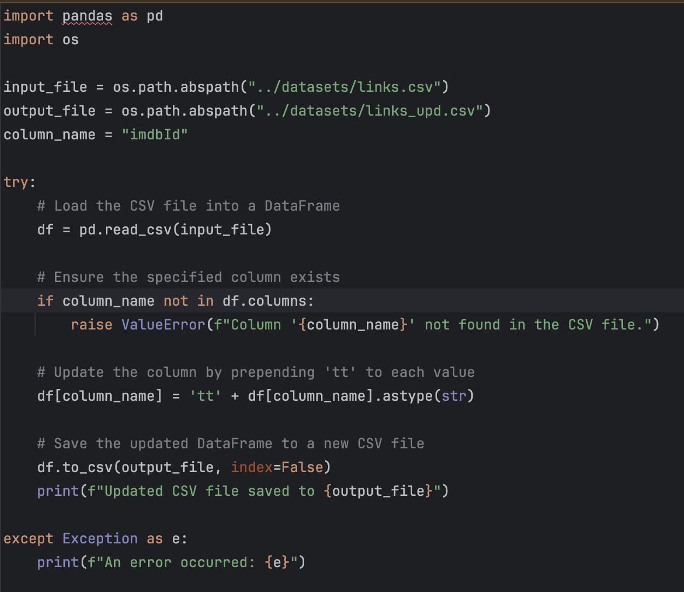
Human resources slide 1
Domain and data sources – Reconciliation issues (6)
Contextual heterogeneity Datasets can refer to the same field using different representation: both IMDB and Movielens sources contain the IMDB ID, but the latter lacks a prefix in the string.
Python preprocessing required to solve the heterogeneity between sources

Slide 12
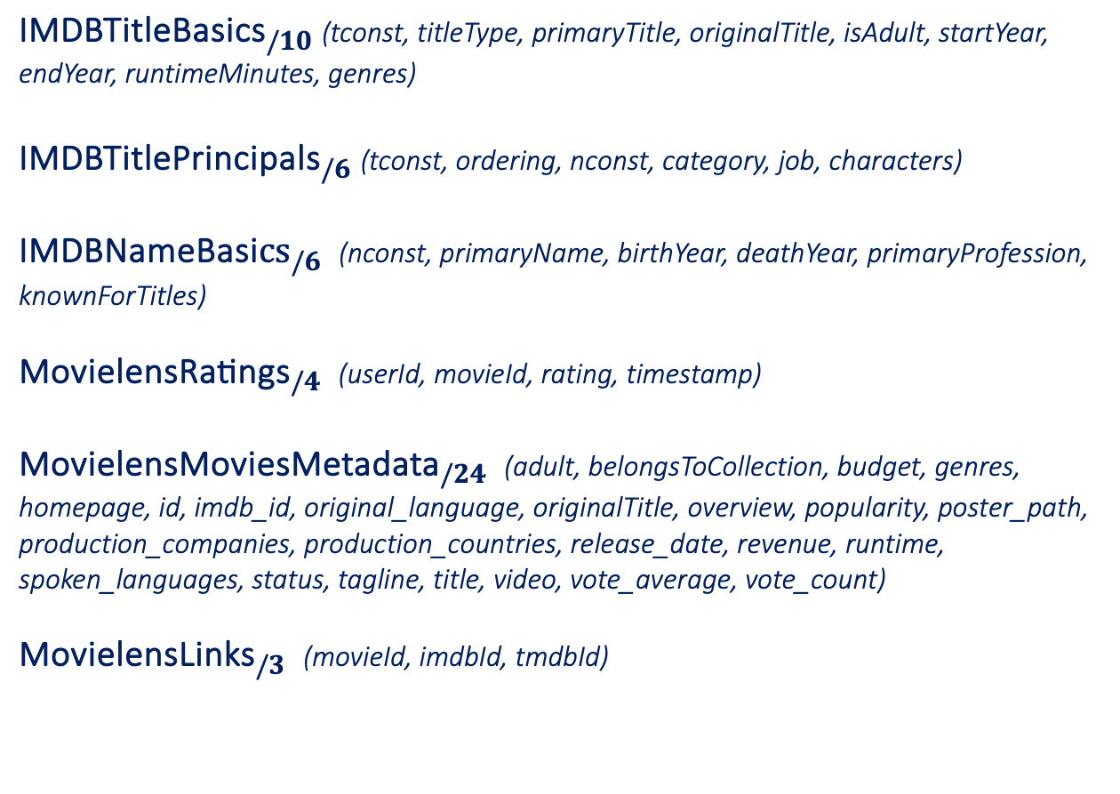
Human resources slide 1
Source schema (1)
${\text{IMDBTitle}\text{Basics}}_{/10}$ (tconst, titleType, primaryTitle, originalTitle, isAdult, startYear, endYear, runtimeMinutes, genres)
${\text{IMDBTitlePrincipals}}_{/6}$ (tconst, ordering, nconst, category, job, characters)
${\text{IMDB}\text{NameBasi}cs}_{/6}$ (nconst, primaryName, birthYear, deathYear, primaryProfession, knownForTitles)
${\text{MovielensRatings}}_{/4}$ (userId, movieId, rating, timestamp)
${\text{MovielensMoviesMetadata}}_{/24}$ (adult, belongsToCollection, budget, genres, homepage, id, imdb_id, original_language, originalTitle, overview, popularity, poster_path, production_companies, production_countries, release_date, revenue, runtime, spoken_languages, status, tagline, title, video, vote_average, vote_count)
${\text{MovielensLinks}}_{/3}$ (movieId, imdbId, tmdbId)

Slide 13
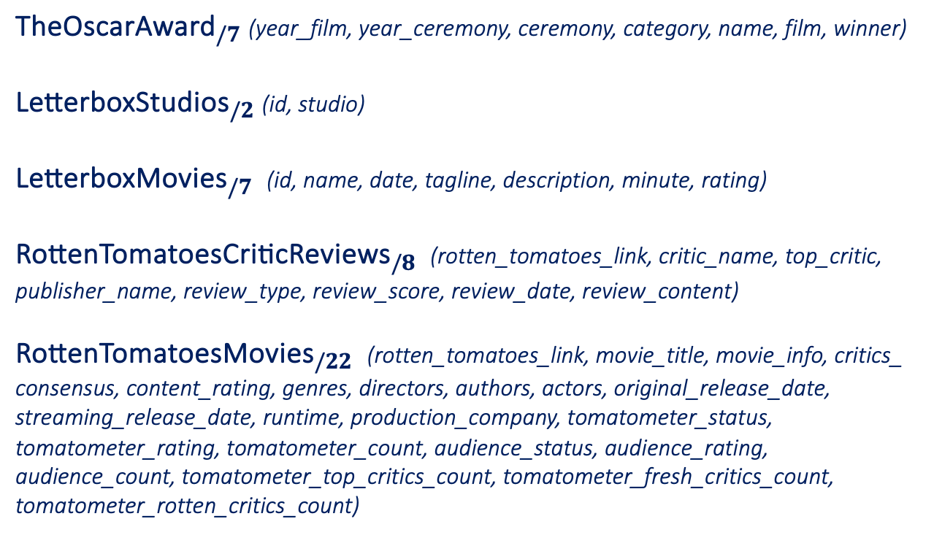
Human resources slide 1
Source schema (2)
${\text{TheOscarAward}}_{/7}$ (year_film, year_ceremony, ceremony, category, name, film, winner)
${\text{LetterboxStudios}}_{/2}$ (id, studio)
${\text{LetterboxMovies}}_{/7}$ (id, name, date, tagline, description, minute, rating)
${\text{RottenTomatoesCriticReviews}}_{/8}$ (rotten_tomatoes_link, critic_name, top_critic, publisher_name, review_type, review_score, review_date, review_content)
${\text{RottenTomatoesMovies}}_{/22}$ (rotten_tomatoes_link, movie_title, movie_info, critics_ consensus, content_rating, genres, directors, authors, actors, original_release_date, streaming_release_date, runtime, production_company, tomatometer_status, tomatometer_rating, tomatometer_count, audience_status, audience_rating, audience_count, tomatometer_top_critics_count, tomatometer_fresh_critics_count, tomatometer_rotten_critics_count)

Slide 14
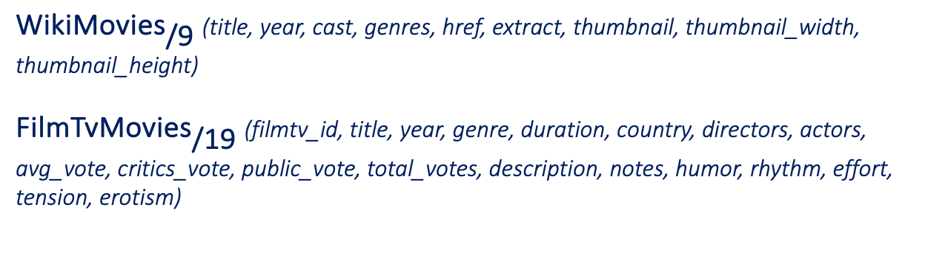
Human resources slide 1
Source schema (3)
Additional sources added for Big Data Management:
${\text{WikiMovies}}_{\text{/9}}$ (title, year, cast, genres, href, extract, thumbnail, thumbnail_width, thumbnail_height)
${\text{FilmTvMovies}}_{\text{/}\text{19}}$ (filmtv_id, title, year, genre, duration, country, directors, actors, avg_vote, critics_vote, public_vote, total_votes, description, notes, humor, rhythm, effort, tension, erotism)

Slide 15
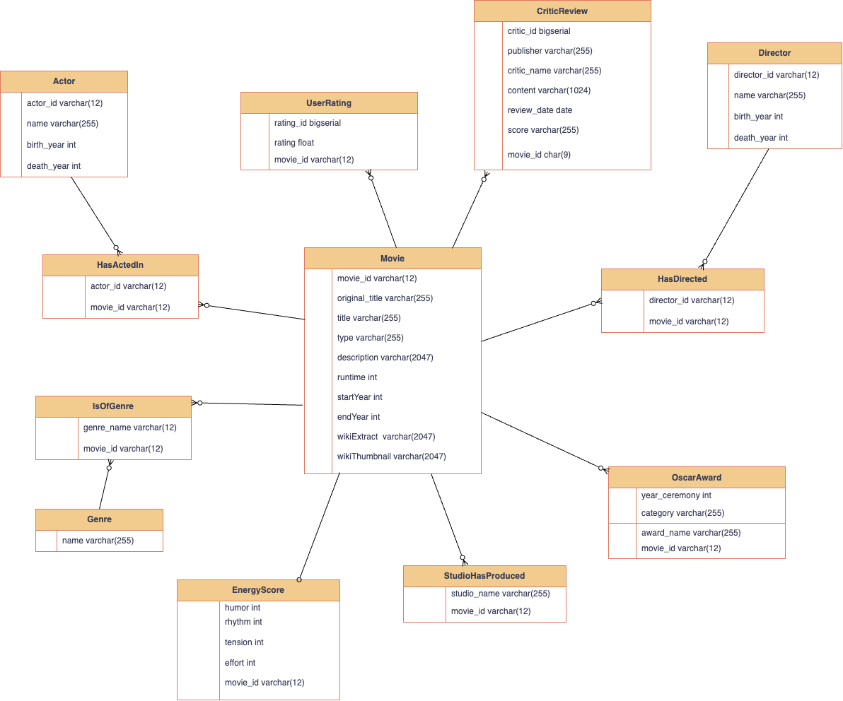
Human resources slide 1
Global schema (1)

Slide 16
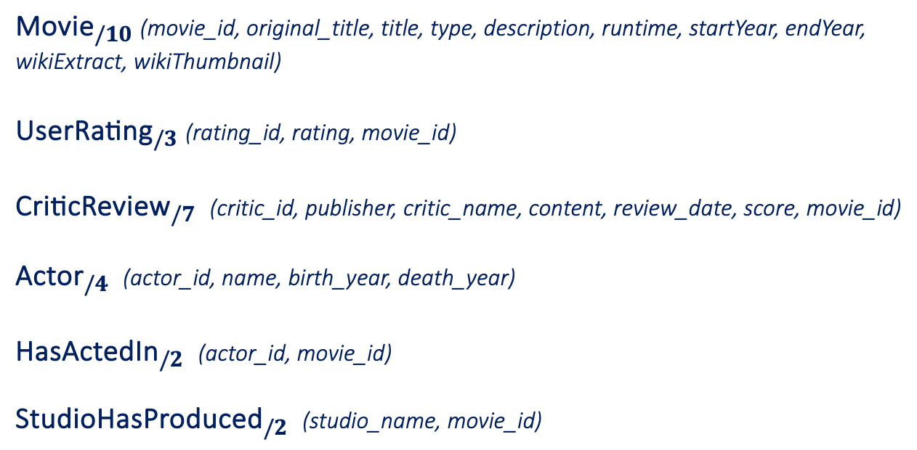
Human resources slide 1
Global schema (2)
${\text{Movie}}_{/10}$ (movie_id, original_title, title, type, description, runtime, startYear, endYear, wikiExtract, wikiThumbnail)
${\text{UserRating}}_{/3}$ (rating_id, rating, movie_id)
${\text{CriticReview}}_{/7}$ (critic_id, publisher, critic_name, content, review_date, score, movie_id)
${\text{Actor}}_{/4}$ (actor_id, name, birth_year, death_year)
${\text{HasActedIn}}_{/2}$ (actor_id, movie_id)
${\text{StudioHasProduced}}_{/2}$ (studio_name, movie_id)

Slide 17
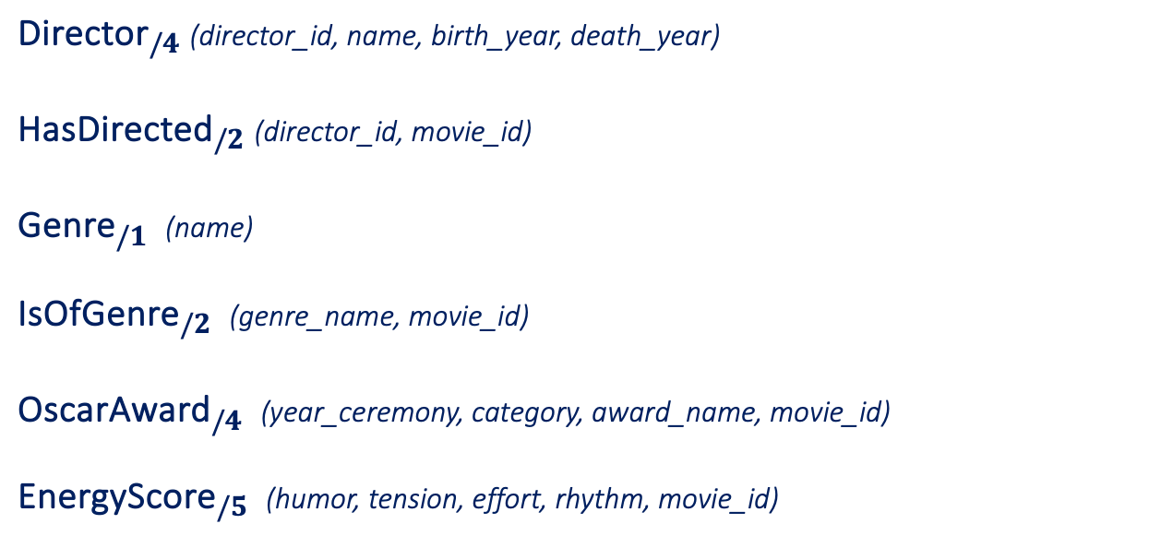
Human resources slide 1
Global schema (3)
${\text{Director}}_{/4}$ (director_id, name, birth_year, death_year)
${\text{HasDirected}}_{/2}$ (director_id, movie_id)
${\text{Genre}}_{/1}$ (name)
${\text{IsOfGenre}}_{/2}$ (genre_name, movie_id)
${\text{OscarAward}}_{/4}$ (year_ceremony, category, award_name, movie_id)
${\text{EnergyScore}}_{/5}$ (humor, tension, effort, rhythm, movie_id)

Slide 18
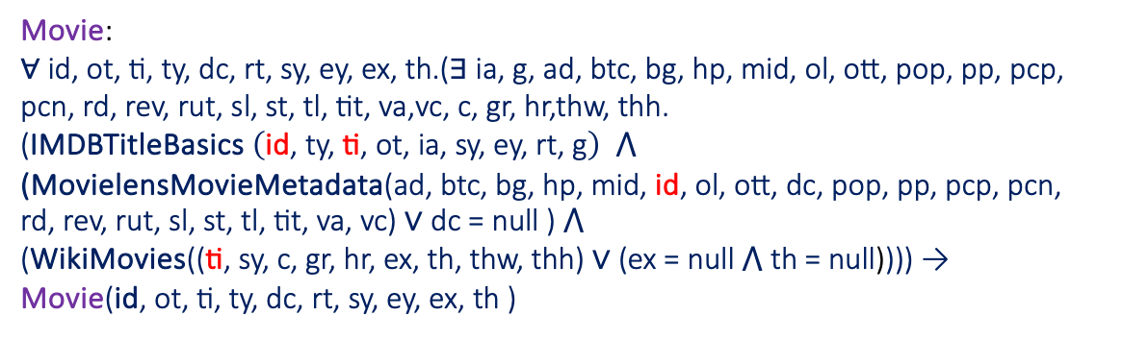
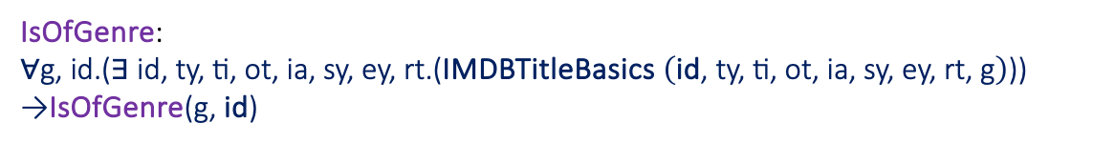
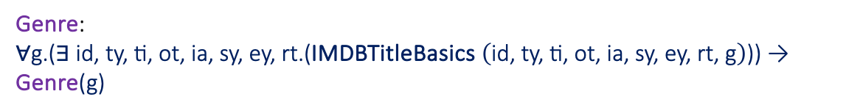

Human resources slide 1
Conjunctive GAV FOL Mappings (1)
Movie:
$$\text{∀} \text{id}\text{, }\text{ot}\text{, }\text{ti}\text{, }\text{ty}\text{, }\text{dc}\text{, }\text{rt}\text{, }\text{sy}\text{, }\text{ey}\text{, }\text{ex}\text{, }\text{th}\text{.(∃ }\text{ia}\text{, }\text{g}\text{, }\text{ad}\text{, }\text{btc}\text{, }\text{bg}\text{, }\text{hp}\text{, }\text{mid}\text{, }\text{ol}\text{, }\text{ott}\text{, }\text{pop}\text{, }\text{pp}\text{, }\text{pcp}\text{, }\text{pcn}\text{, }\text{rd}\text{, }\text{rev}\text{, }\text{rut}\text{, }\text{sl}\text{, }\text{st}\text{, }\text{tl}\text{, }\text{tit}\text{, }\text{va}\text{,}\text{vc}\text{, }\text{c}\text{, }\text{gr}\text{, }\text{hr}\text{,}\text{thw}\text{, }\text{thh}\text{.} \\ \text{(}\text{IMDBTitleBasics} \left(\text{id}\text{, }\text{ty}\text{, }\text{ti}\text{, }\text{ot}\text{, }\text{ia}\text{, }\text{sy}\text{, }\text{ey}\text{, }\text{rt}\text{, }\text{g}\right)\text{ ⋀} \\ \text{(}\text{MovielensMovieMetadata}\text{(}\text{ad}\text{, }\text{btc}\text{, }\text{bg}\text{, }\text{hp}\text{, }\text{m}\text{id}\text{,} \text{id}\text{,} \text{ol}\text{, }\text{ott}\text{, }\text{dc}\text{, }\text{pop}\text{, }\text{p}\text{p}\text{, }\text{pcp}\text{, }\text{p}\text{cn}\text{, }\text{r}\text{d}\text{, }\text{rev}\text{, }\text{rut}\text{, }\text{sl}\text{, }\text{st}\text{, }\text{tl}\text{, }\text{tit}\text{, }\text{va}\text{, }\text{vc}\text{)} \text{∨} \text{dc}\text{ = }\text{null}\text{ ) ⋀} \\ \text{(}\text{WikiMovies}\text{(}\text{(}\text{ti}\text{, }\text{sy}\text{, }\text{c}\text{, }\text{gr}\text{, }\text{hr}\text{, }\text{ex}\text{, }\text{th}\text{, }\text{thw}\text{, }\text{thh}\text{) }\text{∨}\text{ (}\text{ex}\text{ = }\text{null}\text{ ⋀ }\text{th}\text{ = }\text{null}\text{)}\text{)}\text{)}\text{) → } \\ \text{Movie}\text{(}\text{id}\text{, }\text{ot}\text{, }\text{ti}\text{, }\text{ty}\text{, }\text{dc}\text{, }\text{rt}\text{, }\text{sy}\text{, }\text{ey}\text{, }\text{ex}\text{, }\text{th}\text{ )}$$
UserRating:
$$\text{∀}\text{rid}\text{, }\text{r}\text{, }\text{mid}\text{.(∃ }\text{uid}\text{, }\text{mid}\text{2, }\text{ts}\text{, }\text{tid}\text{.(}\text{MovielensRatings} \left(\text{uid}\text{, }\text{mid}\text{2}\text{, }\text{r}\text{, }\text{ts}\right)\text{ ⋀ }\text{MovielensLinks}\text{(}\text{mid}\text{2}\text{, }\text{mid}\text{, }\text{tid}\text{) )) → }\text{UserRating}\text{(}\text{rid}\text{, }\text{r}\text{, }\text{mid}\text{)}$$
Genre:
$$\text{∀}\text{g}\text{.(∃ }\text{id}\text{, }\text{ty}\text{, }\text{ti}\text{, }\text{ot}\text{, }\text{ia}\text{, }\text{sy}\text{, }\text{ey}\text{, }\text{rt}\text{.(}\text{IMDBTitleBasics} \left(\text{id}\text{, }\text{ty}\text{, }\text{ti}\text{, }\text{ot}\text{, }\text{ia}\text{, }\text{sy}\text{, }\text{ey}\text{, }\text{rt}\text{, }\text{g}\right)\text{)}\text{) → }\text{Genre}\text{(}\text{g}\text{)}$$
IsOfGenre:
$$\text{∀}\text{g}\text{, }\text{id}\text{.(∃ }\text{id}\text{, }\text{ty}\text{, }\text{ti}\text{, }\text{ot}\text{, }\text{ia}\text{, }\text{sy}\text{, }\text{ey}\text{, }\text{rt}\text{.(}\text{IMDBTitleBasics} \left(\text{id}\text{, }\text{ty}\text{, }\text{ti}\text{, }\text{ot}\text{, }\text{ia}\text{, }\text{sy}\text{, }\text{ey}\text{, }\text{rt}\text{, }\text{g}\right)\text{)}\text{) →}\text{IsOfGenre}\text{(}\text{g}\text{, }\text{id}\text{)}$$

Slide 19
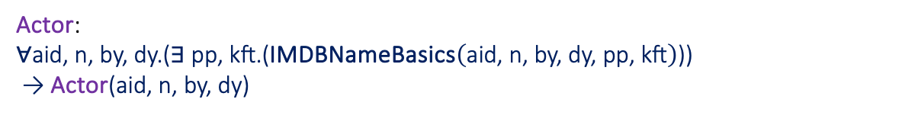
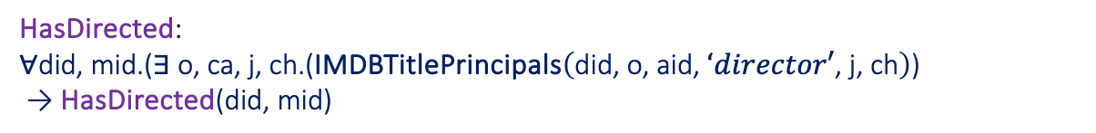
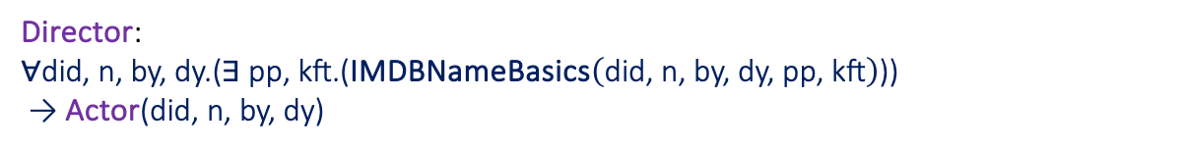
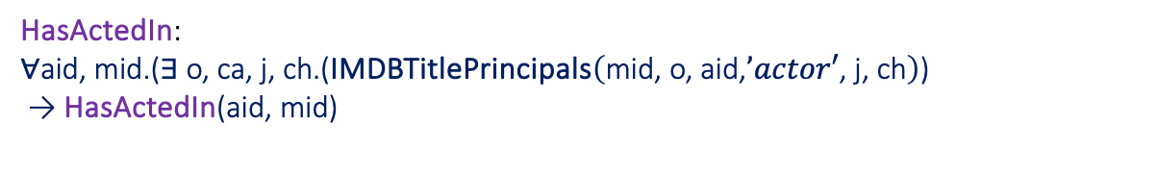
Human resources slide 1
Conjunctive GAV FOL Mappings (2)
Actor:
$$\text{∀}\text{aid}\text{, }\text{n}\text{, }\text{by}\text{, }\text{dy}\text{.(∃ }\text{pp}\text{, }\text{kft}\text{.(}\text{IMDBNameBasics}\left(\text{aid}\text{, }\text{n}\text{, }\text{by}\text{, }\text{dy}\text{, }\text{pp}\text{, }\text{kft}\right)\text{))} \\ \text{ → }\text{Actor}\text{(}\text{aid}\text{, }\text{n}\text{, }\text{by}\text{, }\text{dy}\text{)}$$
HasActedIn:
$$\text{∀}\text{aid}\text{, }\text{mid}\text{.(∃ }\text{o}\text{, }\text{ca}\text{, }\text{j}\text{, }\text{ch}\text{.(}\text{IMDBTitlePrincipals}\left(\text{mid}\text{, }\text{o}\text{, }\text{aid}\text{,}’actor′\text{, }\text{j}\text{, }\text{ch}\right)\text{)} \\ \text{ → }\text{HasActedIn}\text{(}\text{aid}\text{, }\text{mid}\text{)}$$
Director:
$$\text{∀}\text{did}\text{, }\text{n}\text{, }\text{by}\text{, }\text{dy}\text{.(∃ }\text{pp}\text{, }\text{kft}\text{.(}\text{IMDBNameBasics}\left(\text{did}\text{, }\text{n}\text{, }\text{by}\text{, }\text{dy}\text{, }\text{pp}\text{, }\text{kft}\right)\text{))} \\ \text{ → }\text{Actor}\text{(}\text{did}\text{, }\text{n}\text{, }\text{by}\text{, }\text{dy}\text{)}$$
HasDirected:
$$\text{∀}\text{did}\text{, }\text{mid}\text{.(∃ }\text{o}\text{, }\text{ca}\text{, }\text{j}\text{, }\text{ch}\text{.(}\text{IMDBTitlePrincipals}\left(\text{did}\text{, }\text{o}\text{, }\text{aid}\text{, }‘director′\text{, }\text{j}\text{, }\text{ch}\right)\text{)} \\ \text{ → }\text{HasDirected}\text{(}\text{did}\text{, }\text{mid}\text{)}$$

Slide 20
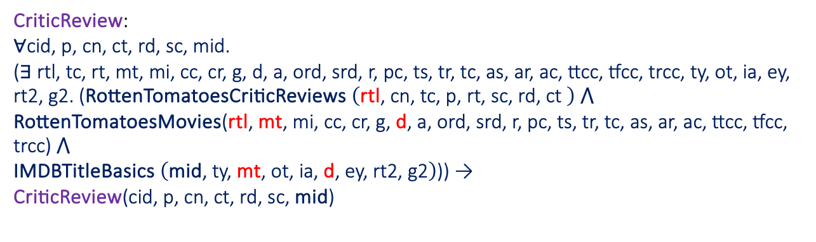
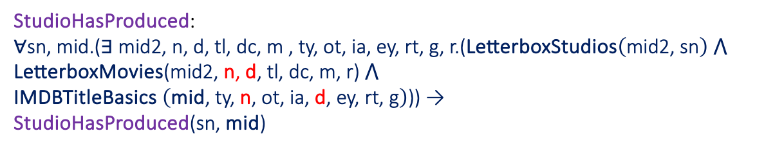
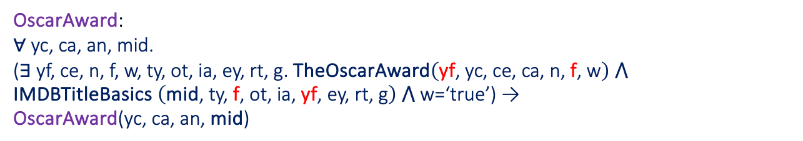
Human resources slide 1
Conjunctive GAV FOL Mappings (3)
CriticReview:
$$\text{∀}\text{cid}\text{, }\text{p}\text{, }\text{cn}\text{, }\text{ct}\text{, }\text{rd}\text{, }\text{sc}\text{, }\text{mid}\text{. }$$
$$\text{(}\text{∃} \text{rtl}\text{, }\text{tc}\text{, }\text{rt}\text{, }\text{mt}\text{, }\text{mi}\text{, }\text{cc}\text{, }\text{cr}\text{, }\text{g}\text{, }\text{d}\text{, }\text{a}\text{, }\text{ord}\text{, }\text{srd}\text{, }\text{r}\text{, }\text{pc}\text{, }\text{ts}\text{, }\text{tr}\text{, }\text{tc}\text{, }\text{as}\text{, }\text{ar}\text{, }\text{ac}\text{, }\text{ttcc}\text{, }\text{tfcc}\text{, }\text{trcc}\text{, }\text{ty}\text{, }\text{ot}\text{, }\text{ia}\text{, }\text{ey}\text{, }\text{rt}\text{2, }\text{g}\text{2. (}\text{RottenTomatoesCriticReviews} \left(\text{rtl}\text{, }\text{cn}\text{, }\text{tc}\text{, }\text{p}\text{, }\text{rt}\text{, }\text{sc}\text{, }\text{rd}\text{, }\text{ct} \right) \text{⋀} \\ \text{RottenTomatoesMovies}\text{(}\text{rtl}\text{, }\text{mt}\text{, }\text{mi}\text{, }\text{cc}\text{, }\text{cr}\text{, }\text{g}\text{, }\text{d}\text{, }\text{a}\text{, }\text{ord}\text{, }\text{srd}\text{, }\text{r}\text{, }\text{pc}\text{, }\text{ts}\text{, }\text{tr}\text{, }\text{tc}\text{, }\text{as}\text{, }\text{ar}\text{, }\text{ac}\text{, }\text{ttcc}\text{, }\text{tfcc}\text{, }\text{trcc}\text{) ⋀} \\ \text{IMDBTitleBasics} \left(\text{mid}\text{, }\text{ty}\text{, }\text{mt}\text{, }\text{ot}\text{, }\text{ia}\text{, }\text{d}\text{, }\text{ey}\text{, }\text{rt}\text{2}\text{, }\text{g}\text{2}\right)\text{)) → } \\ \text{CriticReview}\text{(}\text{cid}\text{, }\text{p}\text{, }\text{cn}\text{, }\text{ct}\text{, }\text{rd}\text{, }\text{sc}\text{, }\text{mid}\text{)}$$
OscarAward:
$$\text{∀} \text{yc}\text{, }\text{ca}\text{, }\text{an}\text{, }\text{mid}\text{.}$$
$$\text{(}\text{∃} \text{yf}\text{, }\text{ce}\text{, }\text{n}\text{, }\text{f}\text{, }\text{w}\text{, }\text{ty}\text{, }\text{ot}\text{, }\text{ia}\text{, }\text{ey}\text{, }\text{rt}\text{, }\text{g}\text{. }\text{TheOscarAward}\left(\text{yf}\text{, }\text{yc}\text{, }\text{ce}\text{,} \text{ca}\text{, }\text{n}\text{, }\text{f}\text{, }\text{w}\right) \text{⋀} \text{IMDBTitleBasics} \left(\text{mid}\text{, }\text{ty}\text{, }\text{f}\text{, }\text{ot}\text{, }\text{ia}\text{, }\text{yf}\text{, }\text{ey}\text{, }\text{rt}\text{, }\text{g}\right) \text{⋀} \text{w}\text{=‘}\text{true}\text{’) → } \\ \text{OscarAward}\text{(}\text{yc}\text{, }\text{ca}\text{, }\text{an}\text{, }\text{mid}\text{)}$$
StudioHasProduced:
$$\text{∀}\text{sn}\text{, }\text{mid}\text{.(∃ }\text{mid}\text{2, }\text{n}\text{, }\text{d}\text{, }\text{tl}\text{, }\text{dc}\text{, }\text{m}\text{ , }\text{ty}\text{, }\text{ot}\text{, }\text{ia}\text{, }\text{ey}\text{, }\text{rt}\text{, }\text{g}\text{, }\text{r}\text{.(}\text{LetterboxStudios}\left(\text{mid}\text{2, }\text{sn}\right) \text{⋀} \text{LetterboxMovies}\text{(}\text{mid}\text{2, }\text{n}\text{, }\text{d}\text{, }\text{tl}\text{, }\text{dc}\text{, }\text{m}\text{, }\text{r}\text{) ⋀} \text{IMDBTitleBasics} \left(\text{m}\text{id}\text{, }\text{ty}\text{, }\text{n}\text{, }\text{ot}\text{, }\text{ia}\text{, }\text{d}\text{, }\text{ey}\text{, }\text{rt}\text{, }\text{g}\right)\text{)) → } \\ \text{StudioHasProduced}\text{(}\text{sn}\text{, }\text{mid}\text{)}$$

Slide 21
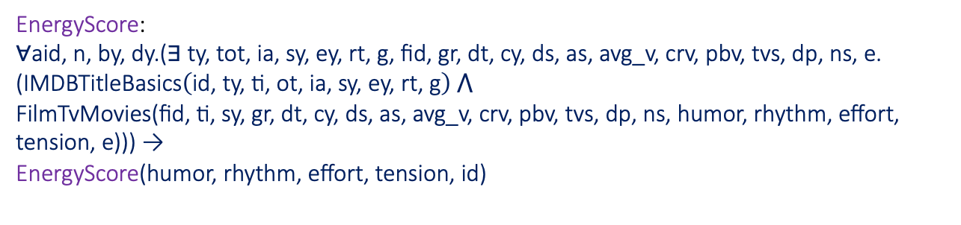
Human resources slide 1
Conjunctive GAV FOL Mappings (4)
EnergyScore:
$$\text{∀}\text{aid}\text{, }\text{n}\text{, }\text{by}\text{, }\text{dy}\text{.(∃ }\text{ty}\text{, }\text{t}\text{ot}\text{, }\text{ia}\text{, }\text{sy}\text{, }\text{ey}\text{, }\text{rt}\text{, }\text{g}\text{, }\text{fid}\text{, }\text{gr}\text{, }\text{dt}\text{, }\text{cy}\text{, }\text{ds}\text{, }\text{as}\text{, }\text{avg}\text{_}\text{v}\text{, }\text{crv}\text{, }\text{pbv}\text{, }\text{tvs}\text{, }\text{dp}\text{, }\text{ns}\text{, }\text{e}\text{.} \\ \text{(}\text{IMDB}\text{TitleBasics}\left(\text{id}\text{, }\text{ty}\text{, }\text{ti}\text{, }\text{ot}\text{, }\text{ia}\text{, }\text{sy}\text{, }\text{ey}\text{, }\text{rt}\text{, }\text{g}\right) \text{⋀} \\ \text{FilmTvMovies}\text{(}\text{fid}\text{, }\text{ti}\text{, }\text{sy}\text{, }\text{gr}\text{, }\text{dt}\text{, }\text{cy}\text{, }\text{ds}\text{, }\text{as}\text{, }\text{avg}\text{_}\text{v}\text{, }\text{crv}\text{, }\text{pbv}\text{, }\text{tvs}\text{, }\text{dp}\text{, }\text{ns}\text{, }\text{humor}\text{, }\text{rhythm}\text{, }\text{effort}\text{, }\text{tension}\text{, }\text{e}\text{)}\text{)) → } \\ \text{EnergyScore}\text{(}\text{humor}\text{, }\text{rhythm}\text{, }\text{effort}\text{, }\text{tension}\text{, }\text{id}\text{)}$$

Slide 22
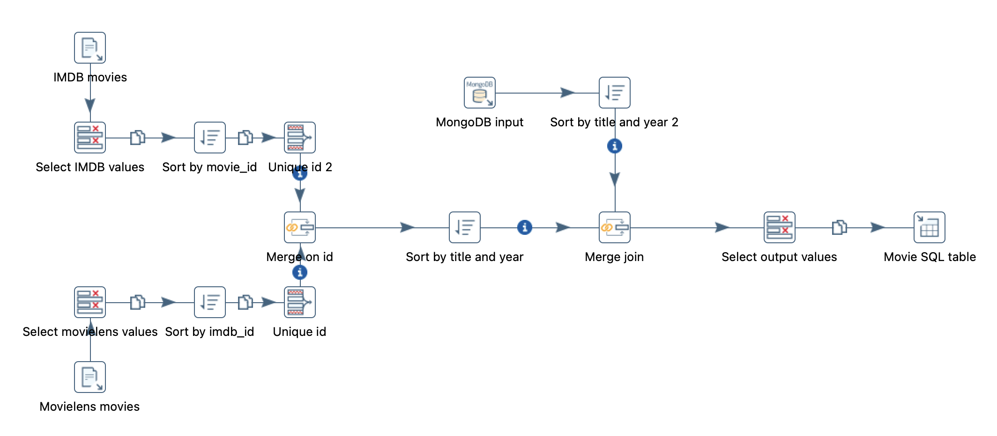
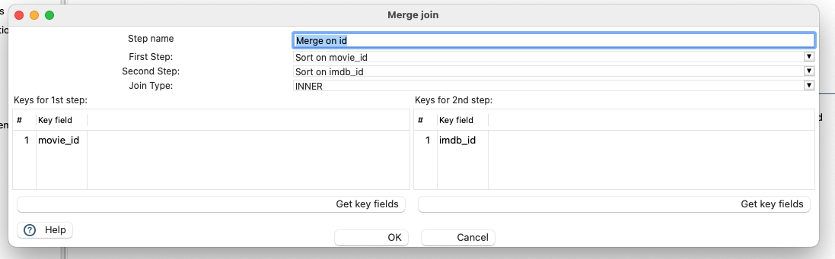
Human resources slide 1
Pentaho implementation (1)
Movie transformation

Slide 23
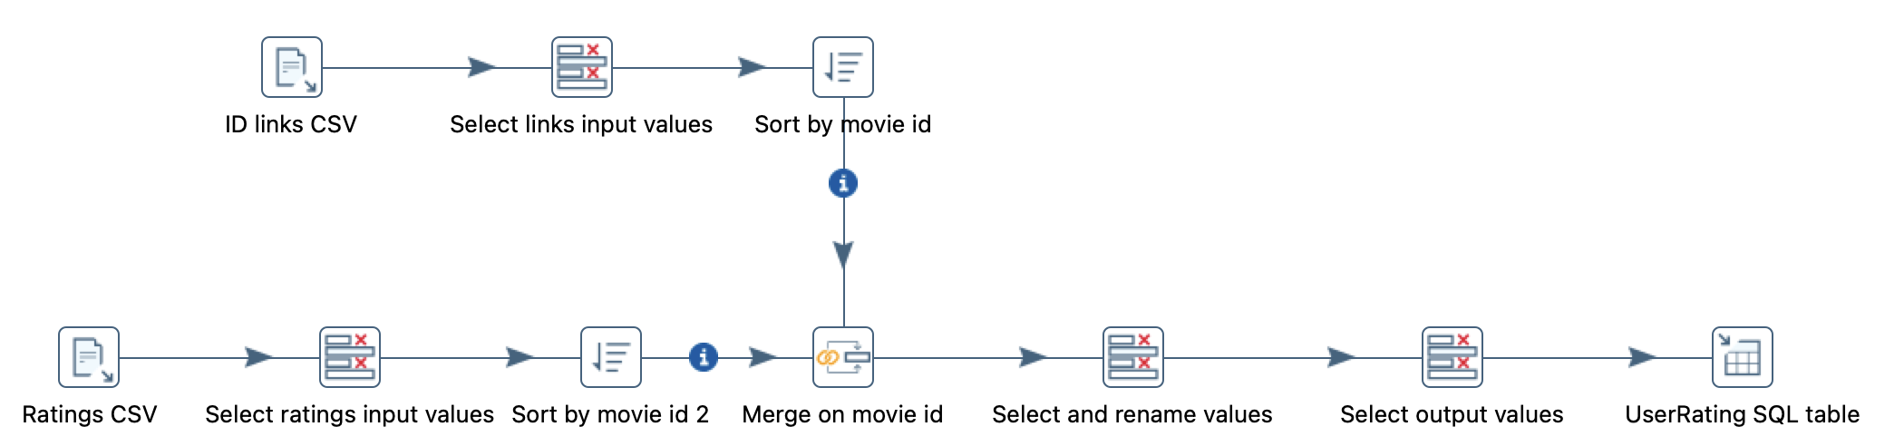
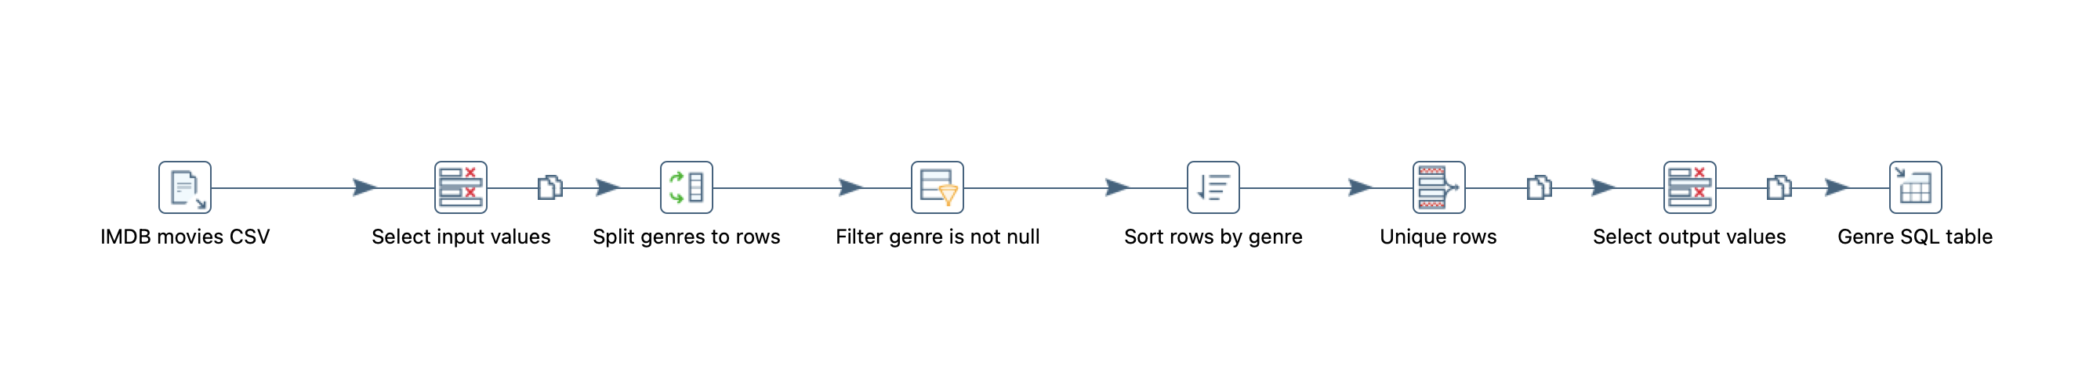
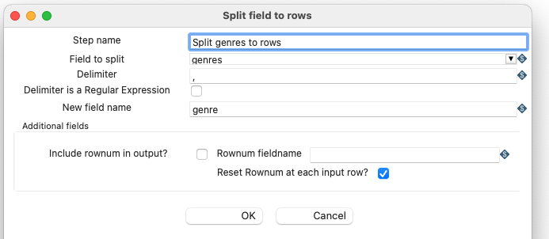
Human resources slide 1
Pentaho implementation (2)
UserRating transformation
Genre transformation

Slide 24
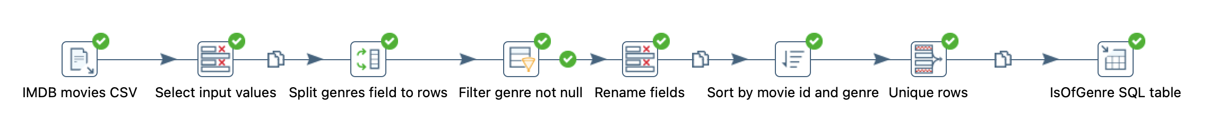
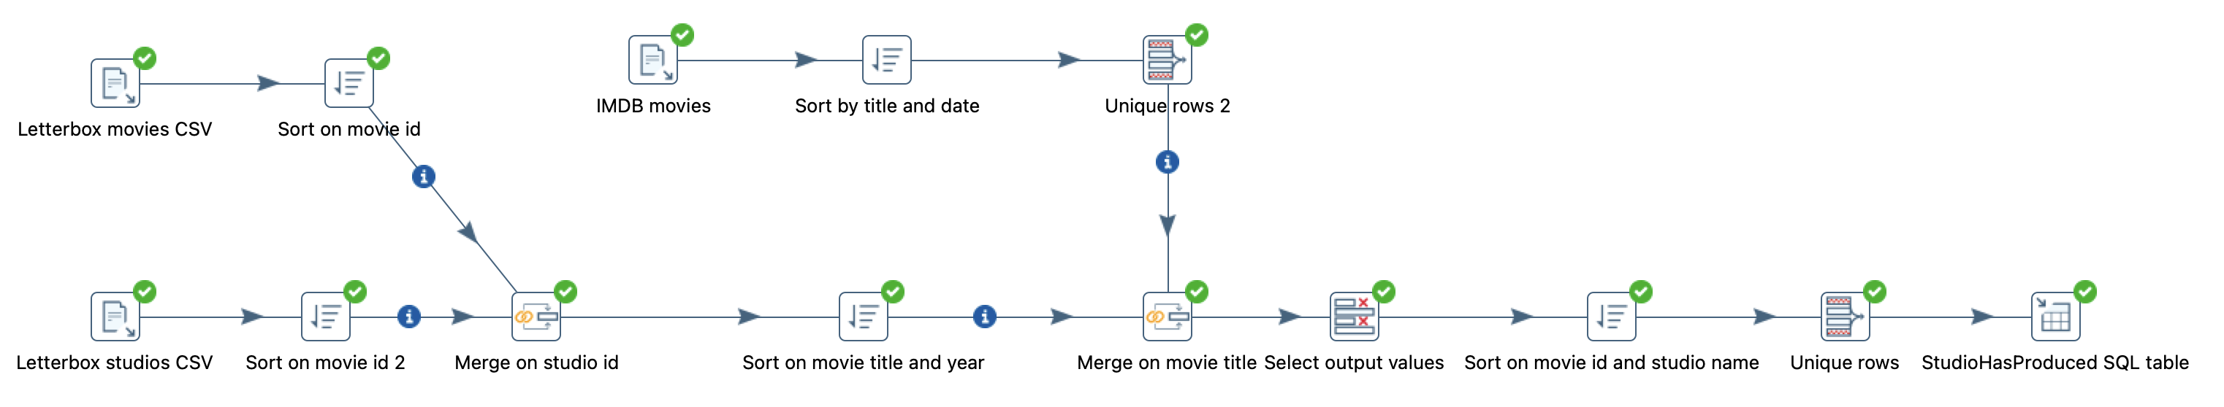
Human resources slide 1
Pentaho implementation (3)
IsOfGenre transformation
StudioHasProduced transformation

Slide 25
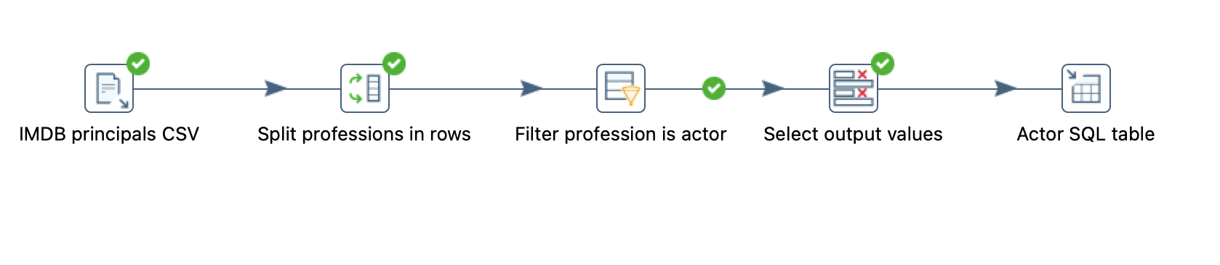
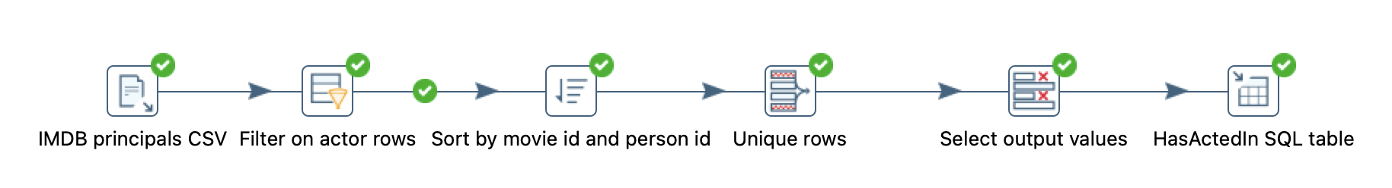
Human resources slide 1
Pentaho implementation (4)
Actor transformation
HasActedIn transformation

Slide 26
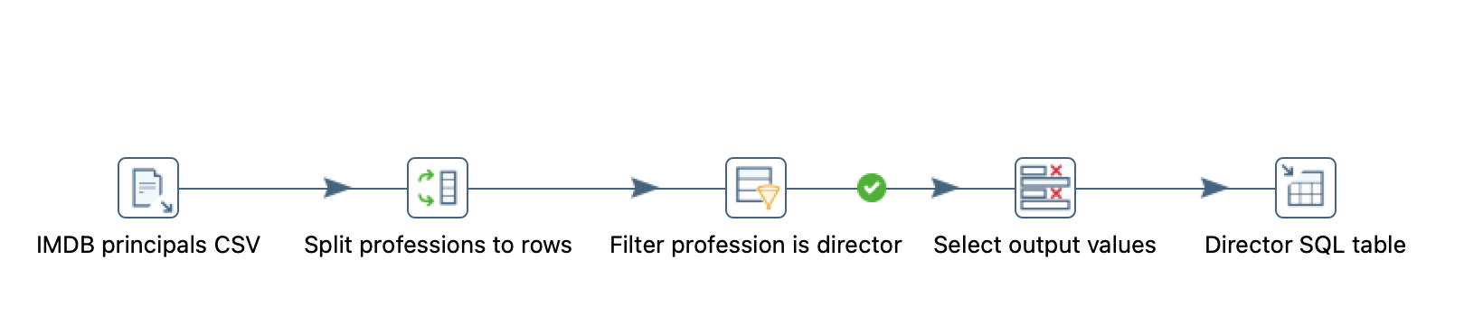
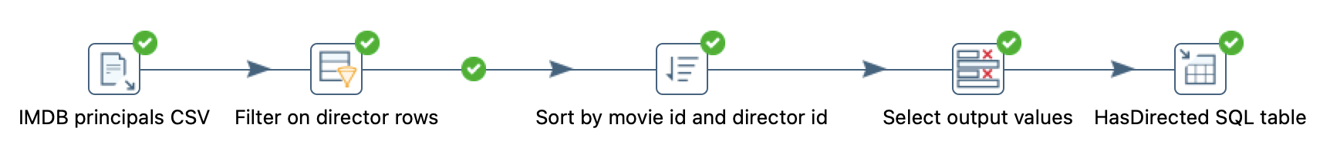
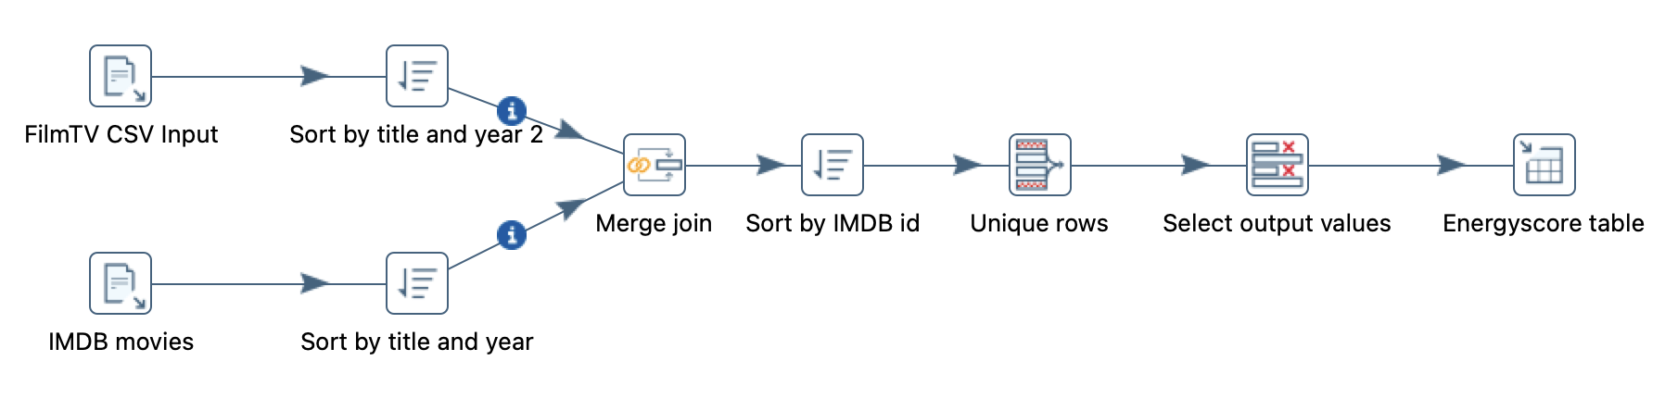
Human resources slide 1
Pentaho implementation (5)
Director transformation
HasDirected transformation
EnergyScore transformation

Slide 27
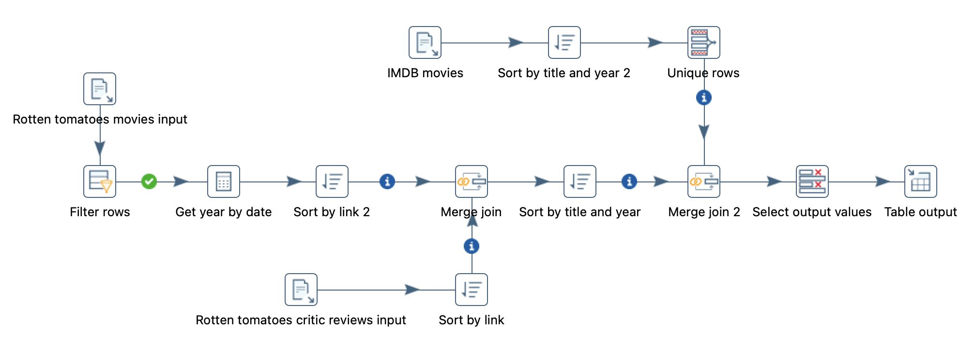
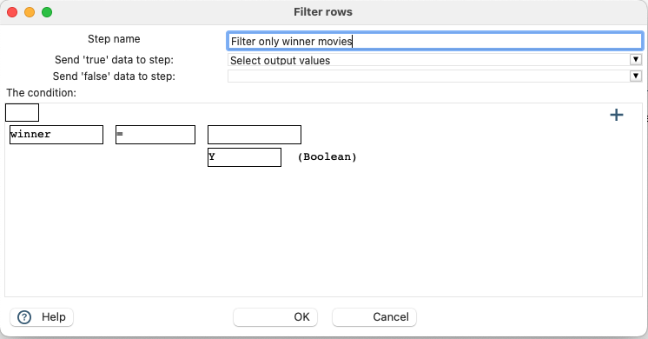
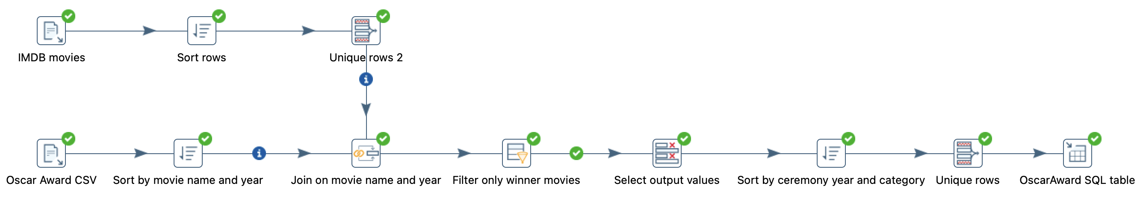
Human resources slide 1
Pentaho implementation (6)
CriticReview transformation
OscarAward transformation
Strange case of duplicate Oscar Award (Aladdin 1993)

Slide 28
Human resources slide 1
Some statistics…
In the RGBD (Retrieved Global Database)
>11.000.000 movies
>26.000.000 reconciled user ratings
>20.000.000 actor appearances
17 minutes each for CriticRating, OscarAward, StudioHasProduced transformations (ran on M1 Pro)
7,09 GBs of source data

Slide 29
Human resources slide 1
Query answering
Given the source database C, now that we have obtained the one-shot materialization of the RGBD (Retrieved Global Database) M(C), we can query it
We have stated that, given a GAV setting without constraints, evaluating a query over M(C) is equivalent to unfolding it and evaluating it over the source database C, from the point of view of computing certain answers

Slide 30
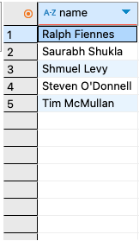
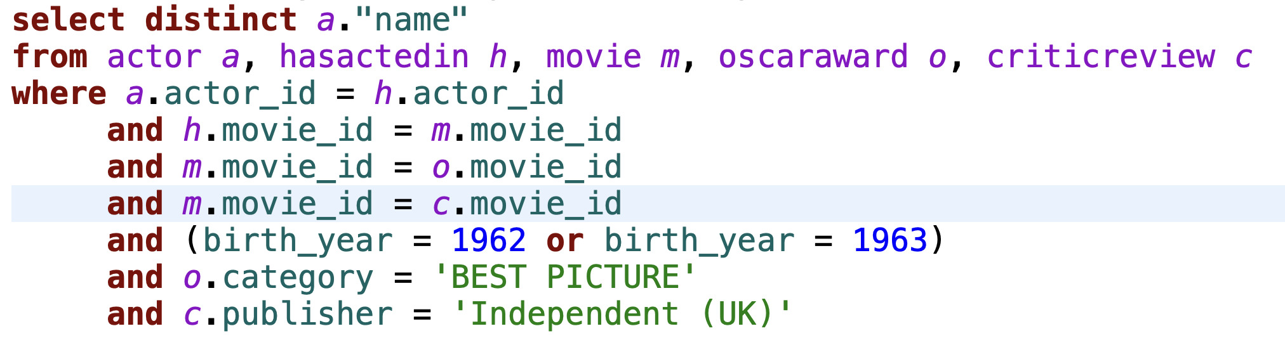
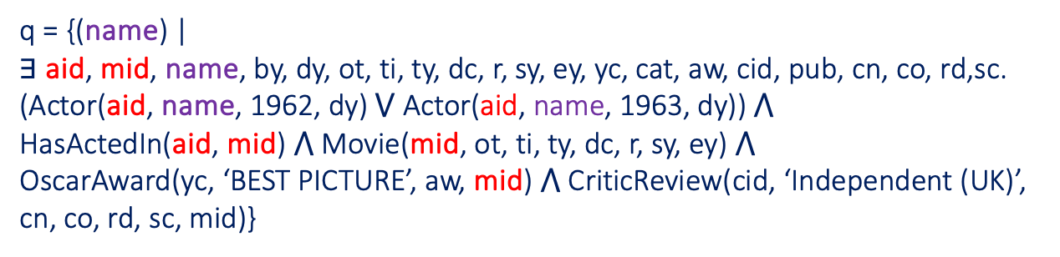
Human resources slide 1
Query 1
Name of actors born in 1962 or 1963 participating in a "Best Picture" Oscar-winning movie, criticized by the Independent (UK) publisher
q = {(name) | $∃$ aid, mid, name, by, dy, ot, ti, ty, dc, r, sy, ey, yc, cat, aw, cid, pub, cn, co, rd,sc. (Actor(aid, name, 1962, dy)$⋁$ Actor(aid, name, 1963, dy)) $⋀$ HasActedIn(aid, mid) $⋀$ Movie(mid, ot, ti, ty, dc, r, sy, ey) $⋀$ OscarAward(yc, ‘BEST PICTURE’, aw, mid) $⋀$ CriticReview(cid, ‘Independent (UK)’, cn, co, rd, sc, mid)}

Slide 31
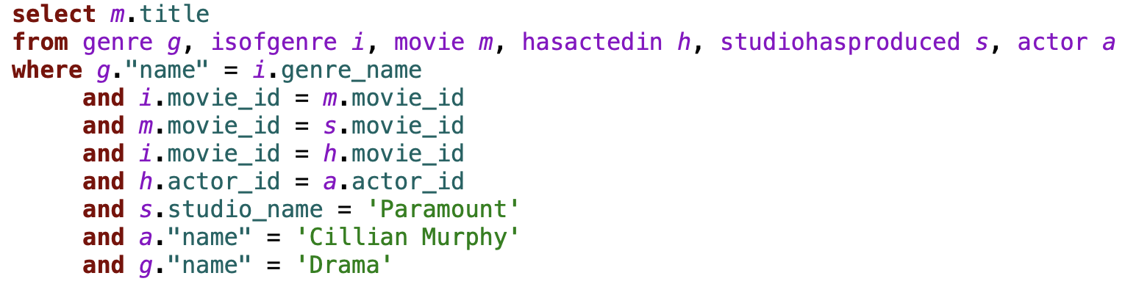
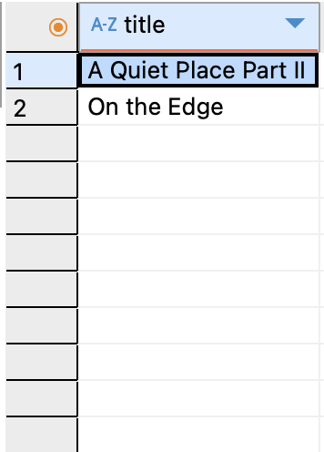
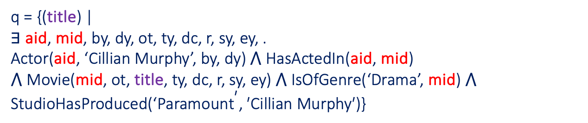
Human resources slide 1
Query 2
Name of movies of genre Drama produced by "Paramount Pictures" where Cillian Murphy acted
q = {(title) | $\text{∃}$ aid, mid, by, dy, ot, ty, dc, r, sy, ey, . Actor(aid, ‘Cillian Murphy’, by, dy) $\text{⋀}$ HasActedIn(aid, mid) $\text{⋀}$ Movie(mid, ot, title, ty, dc, r, sy, ey) $\text{⋀}$ IsOfGenre(‘Drama’, mid) $\text{⋀} \text{StudioHasProduced}\text{(‘}\text{Paramoun}{\text{t}}^{\text{′}}\text{, ′}\text{Cillian} \text{Murphy}\text{′)\}}$

Slide 32
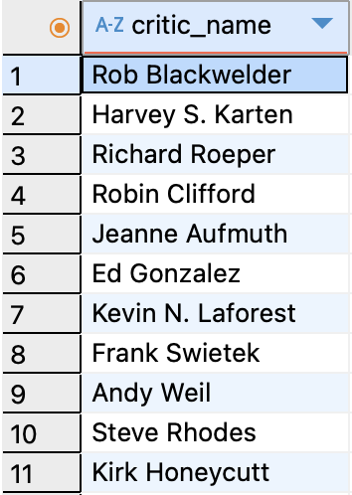
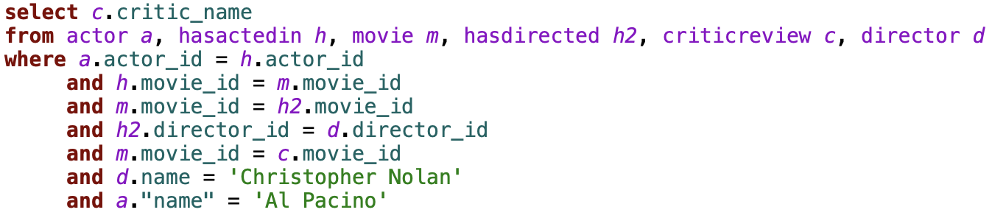
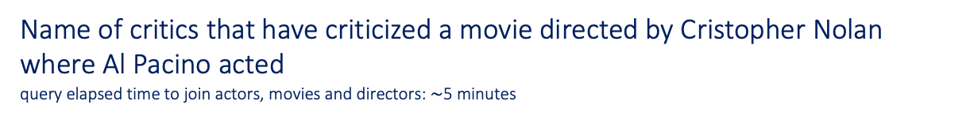
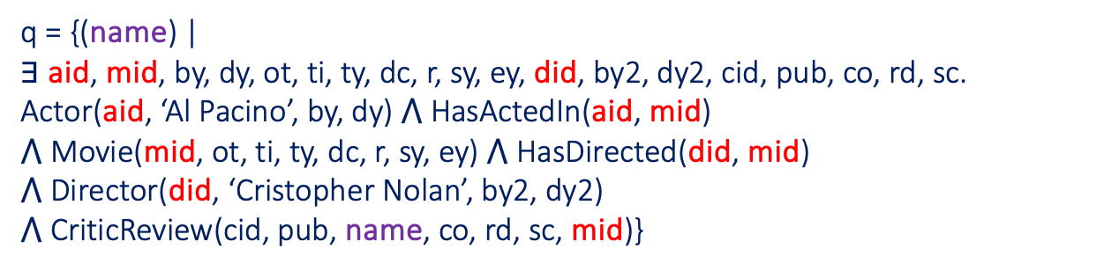
Human resources slide 1
Query 3
Name of critics that have criticized a movie directed by Cristopher Nolan where Al Pacino acted
query elapsed time to join actors, movies and directors: $\text{\sim }$5 minutes
q = {(name) | $\text{∃}$ aid, mid, by, dy, ot, ti, ty, dc, r, sy, ey, did, by2, dy2, cid, pub, co, rd, sc. Actor(aid, ‘Al Pacino’, by, dy) $\text{⋀}$ HasActedIn(aid, mid) $\text{⋀}$ Movie(mid, ot, ti, ty, dc, r, sy, ey) $\text{⋀} \text{HasDirected}\text{(}\text{did}\text{, }\text{mid}\text{)}$ $$\text{⋀ }\text{Director}\text{(}\text{did}\text{,} \text{‘}\text{Cristopher} \text{Nolan}\text{’, }\text{by}\text{2}\text{, }\text{dy}\text{2}\text{)}$$ $⋀$ CriticReview(cid, pub, name, co, rd, sc, mid)}

Slide 33
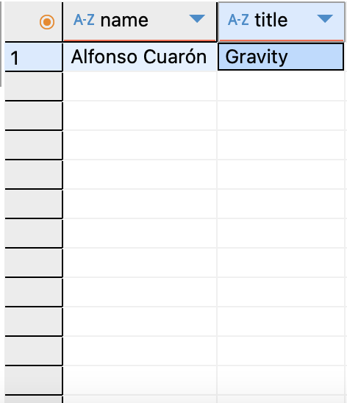
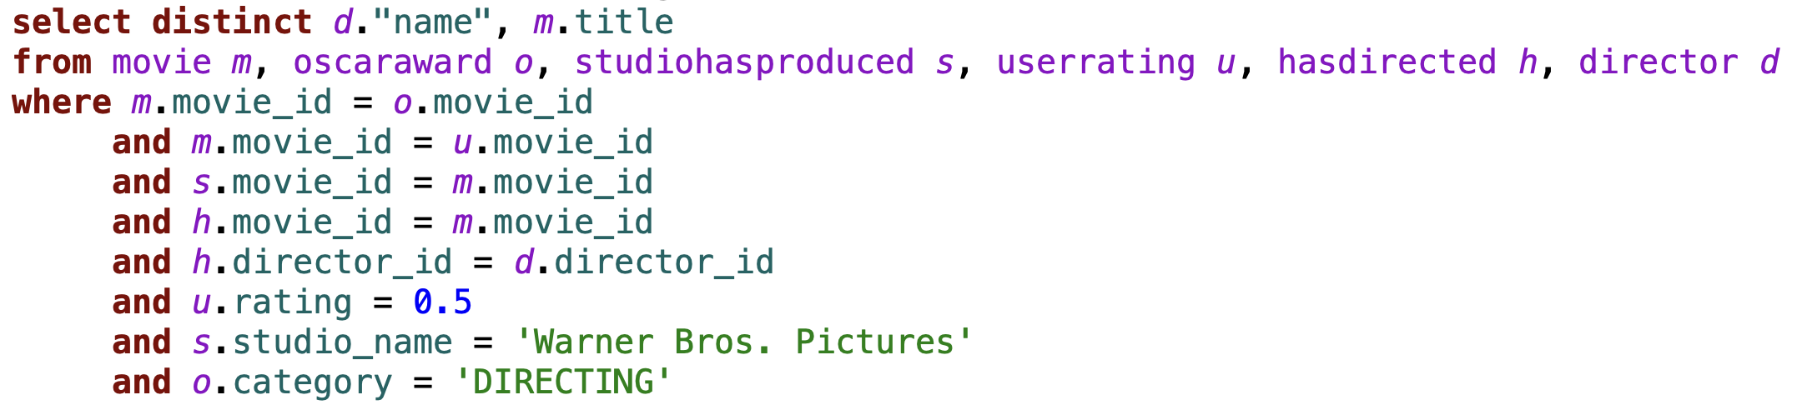
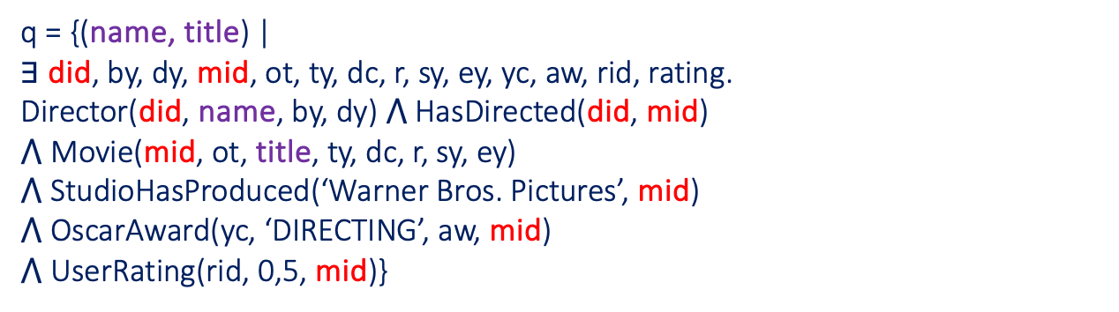
Human resources slide 1
Query 4
Name of directors and movie titles of oscar-winning movies in the DIRECTING category, produced by Warner Bros, with at least one user rating of 0.5
q = {(name, title) | $∃$ did, by, dy, mid, ot, ty, dc, r, sy, ey, yc, aw, rid, rating. Director(did, name, by, dy) $⋀$ HasDirected(did, mid) $⋀$ Movie(mid, ot, title, ty, dc, r, sy, ey) $⋀$ StudioHasProduced(‘Warner Bros. Pictures’, mid)
$⋀$ OscarAward(yc, ‘DIRECTING’, aw, mid) $⋀$ UserRating(rid, 0,5, mid)}

Slide 34
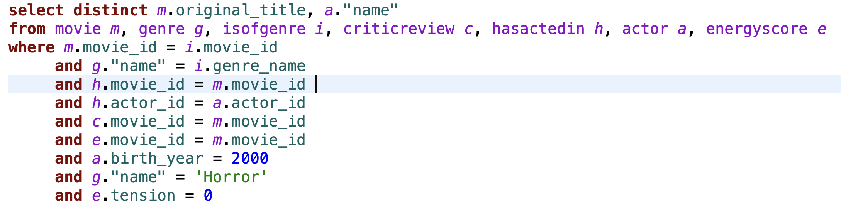
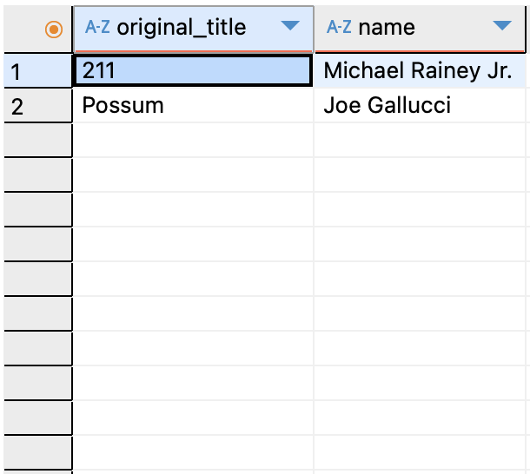
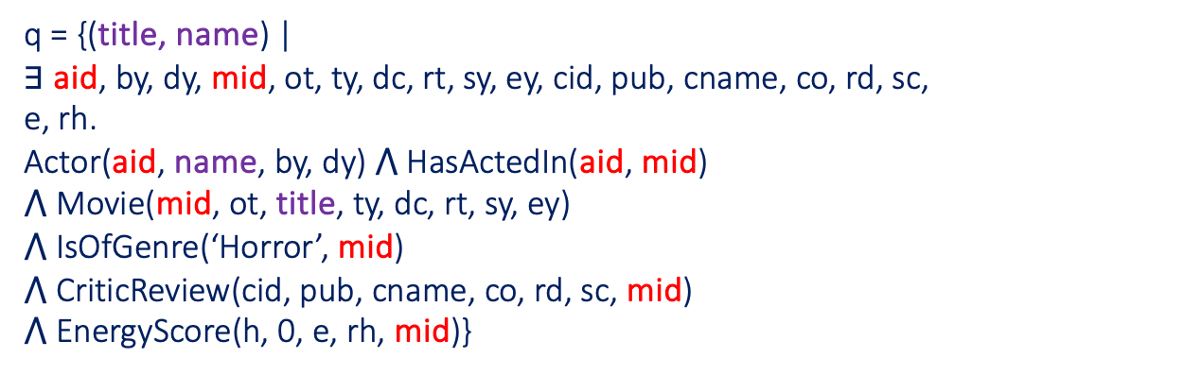
Human resources slide 1
Query 5
Title of horror movies and name of actors participating, born in the year 2000, with a critic review on rotten tomato, and a tension score of 0
q = {(title, name) | $\text{∃}$ aid, by, dy, mid, ot, ty, dc, rt, sy, ey, cid, pub, cname, co, rd, sc, e, rh. Actor(aid, name, by, dy) $\text{⋀}$ HasActedIn(aid, mid) $\text{⋀}$ Movie(mid, ot, title, ty, dc, rt, sy, ey) $\text{⋀}$ IsOfGenre(‘Horror’, mid) $\text{⋀}$ CriticReview(cid, pub, cname, co, rd, sc, mid) $\text{⋀}$ EnergyScore(h, 0, e, rh, mid)}

Slide 35
Human resources slide 1
…Thanks!
References
Theoretical notions: LSDM course taught by prof. Antonella Poggi
Github: Github repository
Datasets: see README file in repository
Guide link to install Pentaho Kettle on Apple Silicon

